Slide 1


Phylogeny: construction, visualization and interpretation
February 2023
Erkison Ewomazino Odih
SEQAFRICA, University of Ibadan, Nigeria University of Copenhagen, Denmark

Slide 2
Outline
Phylogeny inference from SNPs
Phylogenetic tree construction
Phylogenetic tree interpretation
Phylogenetic tree visualization – Microreact

Slide 3
Phylogeny
Phylogeny represents the evolutionary relationships and relatedness between a group of organisms.
Inferred from single nucleotide polymorphisms (SNPs)
SNPs are allelic nucleotide variants at given positions in the genome.
For phylogeny analyses, SNPs are assumed to be:
Independent
Random

Slide 4
Inferring phylogeny from SNPs – Overview
Select reference and map reads to reference
The closer the reference to the sample data, the better.
Reference region with no matching reads
Reads not matching reference
Mapping/ alignment
Raw reads (Post QC)
Reference sequence
Software: BWA mem, samtools, Mauve…

Slide 5
Inferring phylogeny from SNPs – Overview
2. Call SNPs / variant calling and filtering of low quality SNPs
T
T T
T
T C C C
A A
A
C G C G C G A G C G A G
C C C
T
T
T
A
C
C C
C G A G C
T
T
C G A T C
C G A G C
A A GT A
G
Reference sequence
Software: Samtools, VarScan, bcftools…

Slide 6
Inferring phylogeny from SNPs – Overview
3. Filter recombination (optional)
Remove SNPs due to recent recombination events e.g mobile elements
Often identified by relative SNP densities (clustering) along the alignment
T
T T
T
T C C C
A A
A
C G C G C G A G C G A G C G A G
C C C C C
T
T
T
A
C
C C
T
T
C G A T C G A G A A GT
C
G
A
Reference sequence Software: Gubbins…

Slide 7
Inferring phylogeny from SNPs – Overview
Concatenate filtered SNPs to create pseudogenomes and a pseudoalignment.
Constructed from only shared positions in all genomes and reference
T
T T
T T C
C C
A A
A
C C
C C C
C A
Isolate 1: TTAC
Isolate 2: TTAC
Isolate 3: TTAC
Isolate 4: TTAC
Isolate 5: TCCC
Isolate 6: TCCC
Pseudoalignment
T
T
Alignment
T
A
C
C C
T
T
G
Reference sequence

Slide 8
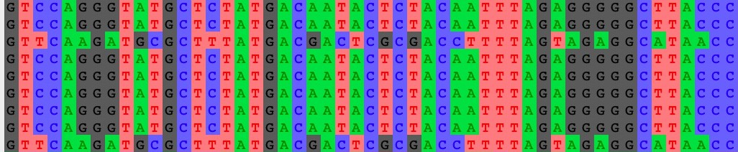
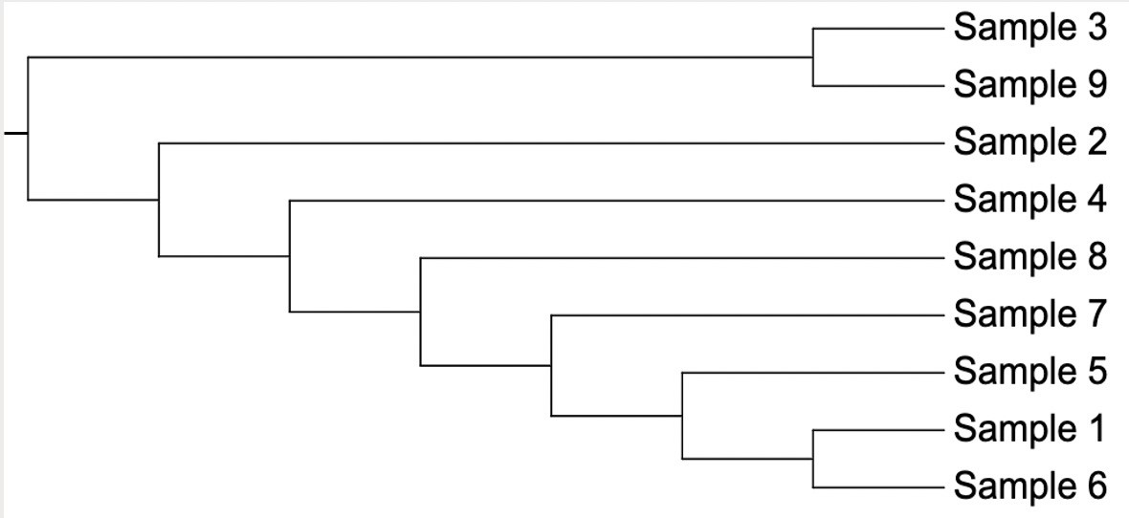
Inferring phylogeny from SNPs – Overview
5. Construct phylogenetic tree from pseudoalignment using chosen method and algorithm.
Sample 1
Sample 2
Sample 3
Sample 4
Sample 5
Sample 6
Sample 7
Sample 8
Sample 9
Pseudoalignment
Tree construction
Software: IQ-Tree, FastTree, RaxML

Slide 9
Phylogenetic tree interpretation
Node and hypothetical ancestor of isolates 1 and 2
Taxon
Taxa are on the tree tips/leaves
Nodes: hypothetical taxa ancestors
Branches connect nodes and taxa
Topology: branching structure of a tree
Clade: taxa sharing a unique common ancestor
Bootstraps: proportion of multiple replicate trees supporting each node.
Root: more distantly related to all taxa on the tree; tells direction of evolution
Branch
Isolate 1
Most recent
hypothetical
0.9
ancestor of
studied isolates
Isolate 2
1.0
Isolate 3
Isolate 4
0.7
0.9
Isolate 5
80%
bootstrap
0.8
Isolate 6
support
Root
Scale
0.1

Slide 10
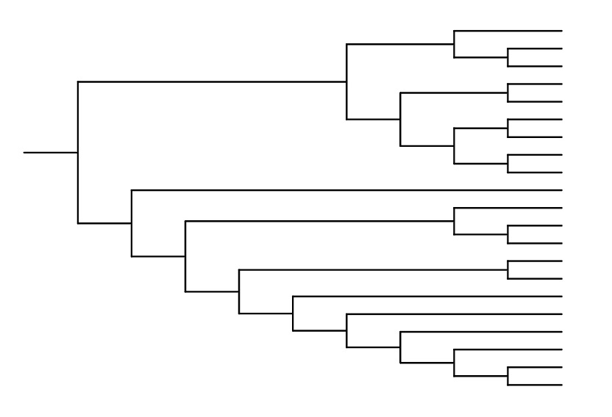
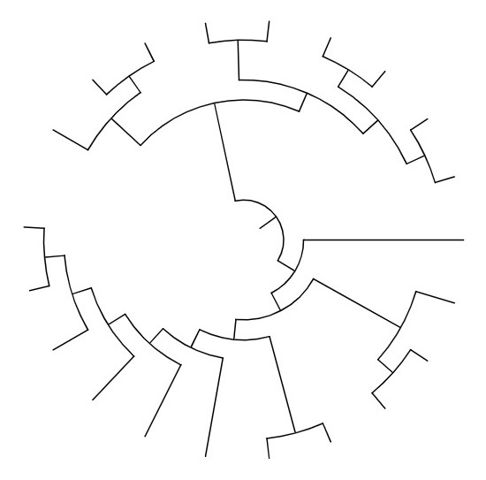
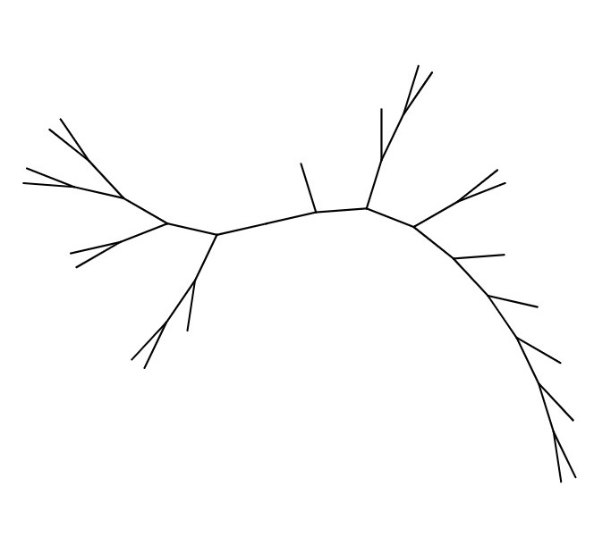
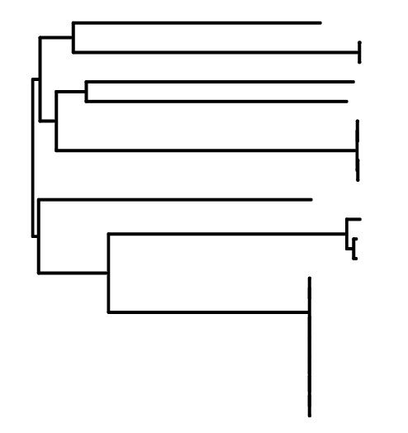
Phylogenetic tree interpretation
Reading phylogenetic trees
Trees depict branching history; topology most important.
Different orientations, same topology.
Unless otherwise indicated, branch lengths are meaningless; avoid inferring temporal information that is not shown
Branch lengths, when indicated, reflect the amount of evolutionary change as well as the passage of time.
x
y
x
y
0.01

Slide 11






















Phylogenetic tree interpretation: Misconceptions
1. Evolutionary timeline flows from tips/leaves
Present
Past
Past
Present
Evolution is not linear but nested
2. Related species have proximal leaves
==
Relationships are inferred from common ancestry, not leaf proximity

Slide 12

















Phylogenetic tree interpretation: Misconceptions
3. Genetic change occurs only at nodes
Fact:
Changes accumulate in taxa over time and are present along branches
Nodes simply represent (hypothetical) common ancestors between taxa
Shared ancestor; divergence event
Unique ancestor
D
C
B
A
4. Related species have fewer connecting nodes
3 connecting nodes = less related
2 connecting nodes = more related

Slide 13
Phylogenetic tree visualisation: Microreact
A flexible, interactive software/web application for easy visualization of datasets consisting of a combination of trees, maps, timelines, and associated metadata.
Input:
Data file: Comma separated values (.csv) format; can contain a combination of textual metadata, locations and dates.
Optional tree file: Newick (.nwk) format.
Output: interactive tree, map, timeline, and table.

Slide 14
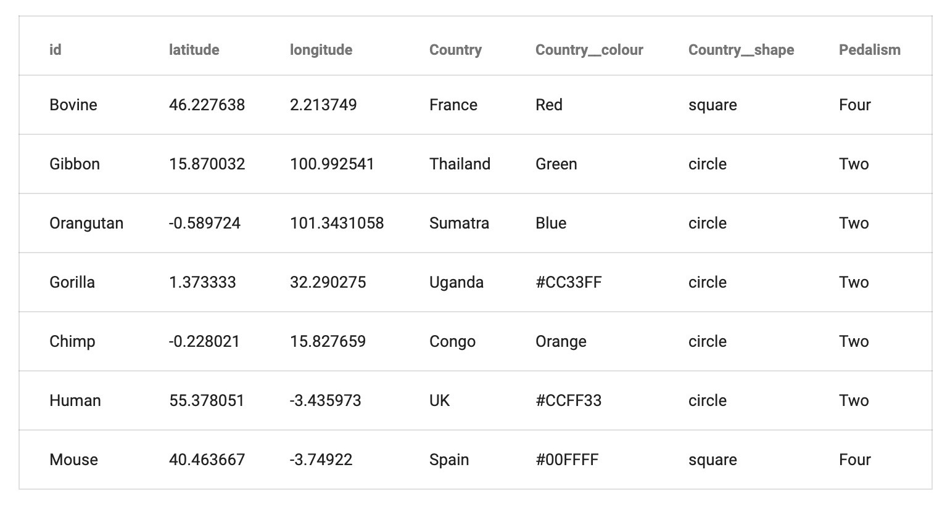
Phylogenetic tree visualisation: Microreact
Sample data file
Mandatory column
id
– unique identifier for each data row
Optional columns
latitude, – geographic columns
longitude
year, month,
day
temporal columns
other metadata
<custom-name>
<column-name> colour
specify colour
specify shape
https://microreact.org/instructions
<custom-name> shape

Slide 15
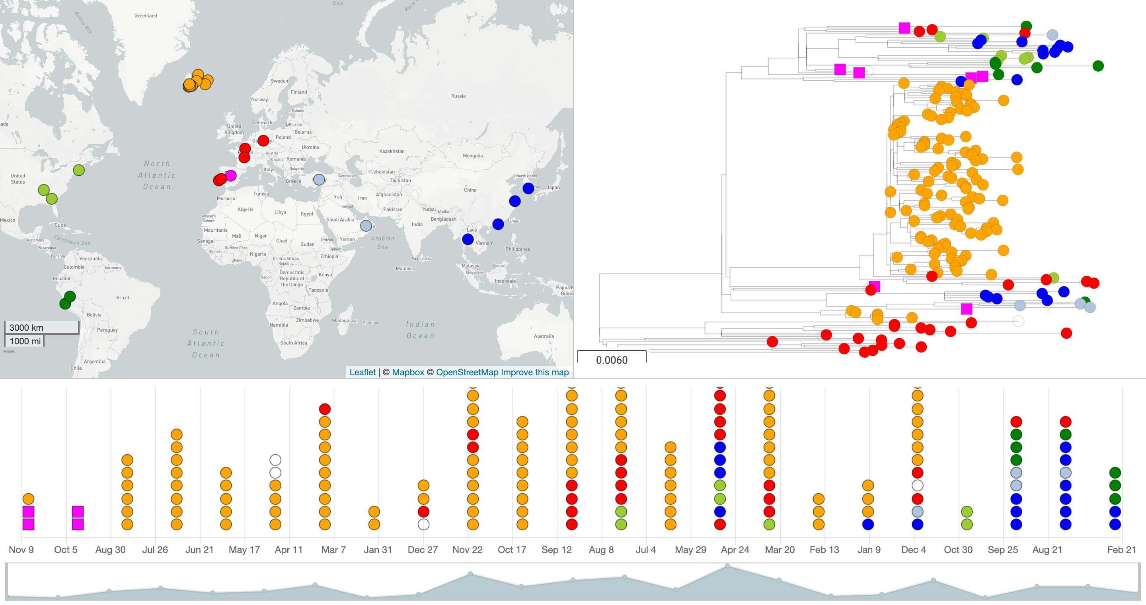




Phylogenetic tree visualisation: Microreact
Data file (.csv)
+/-
Web application https://microreact.org
Tree file (.nwk)
Source: https://microreact.org/project/N1TRn11L

Slide 16
Microreact benefits
Powerful visualization and data exploration
Visualization can be shared as a permanent web link among collaborators.
The web link can be embedded within publications to enable readers to explore and download the data.
Simple and easy-to-use, yet powerful

Slide 17

Microreact demo

Slide 18








Thank you
This programme is being funded by the UK Department of Health and Social Care. The views expressed do not necessarily reflect the UK Government’s official policies.

